Slide 1

DEPARTMENT OF PHARMACEUTICAL TOXICOLOGY
T.C.
MERSİN UNIVERSITY
INSTITUTE OF HEALTH SCIENCES
GRADUATE PROGRAMS
2025

Slide 2


HISTORY
Our Department is currently working with 3 faculty members, 1 Professor, 1 Associate professor and 1 Assistant Professor. Our Department has one student laboratory and one research laboratory. In our research laboratory, studies on molecular toxicology, analytical toxicology, forensic toxicology, genetic toxicology, environmental toxicology, genetic polymorphism are carried out. In the Department of Pharmaceutical Toxicology, in the letter dated 24/12/2008 and numbered B.30.0.EÖB.0.00.00.03.02.03-4969 of the Presidency of the Council of Higher Education (YÖK), it was approved to open a joint Pharmaceutical Toxicology Master's Programme with Gazi University within Mersin University Institute of Health Sciences. Since this date, graduate education has been given and the Joint Graduate Programme has been closed with the decision of YÖK dated 25/09/2019 and numbered 75850160-104.01.04.01-E.70451.
Pharmaceutical Toxicology Department Master's Programme was reopened with the decision of the General Assembly of Higher Education in the letter of the Presidency of the Council of Higher Education dated 11.04.2022 and numbered E-75850160-104.01.04.01-14171. Within the scope of the Master's Program, there are 2 professors, 1 associate professor and 1 doctoral faculty member included in the qualification list of the program, and there are graduate students enrolled in the program.

Slide 3
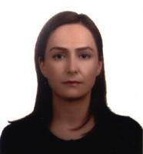
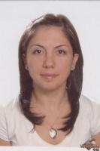
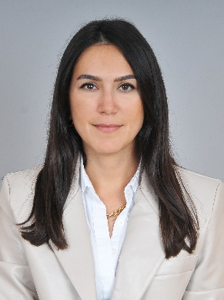
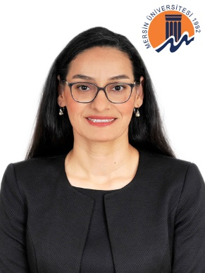
ACADEMIC STAFF
Prof. Dr. Dilek BATTAL
Anabilim Dalı Başkanı
Prof. Dr. Seyhan ŞAHAN FIRAT
Doç. Dr. Zuhal UÇKUN ŞAHİNOĞULLARI
Dr. Öğr. Üyesi Ayça AKTAŞ ŞÜKÜROĞLU

Slide 4
FILEDS OF RESEARCH
Analytical Toxicology (GC-NPD, GC-ECD, GC-MS, LC-MS/MS, HPLC, ICP-MS, cell sorter - flow cytometry analyses)
Forensic Toxicology (structural identification of illegal substances (natural and synthetic) (FTIR, NMR analyses)
Qualitative and quantitative analyses using GC-MS and LC-MS/MS instruments
Biosensor development studies
Genotoxicity (MN, SCE, and COMET tests)
Cytotoxicity studies (cell culture, cell sorter-flow cytometry analyses)
Molecular toxicology studies Toxicogenetic/pharmacogenetic studies

Slide 5
PROGRAM COMPETENCIES
Explain general toxicology terms
Express toxicokinetic mechanisms
Express factors affecting toxicity
Distinguish general and specific toxic effects
Explain toxicology subdivision of field activities.
Assessment substances toxic on human and environment
Design risk assessment in toxicology
To gain skill to use toxicology information sources and their evaluation
To write the research and/or reviews on various topics related to toxicology
To make presentations on various topics related to toxicology
To make analysis in biological materials using various methods and techniques.

Slide 6
EMPLOYMENT OPPORTUNITIES
Graduates of the Master's Program in Pharmaceutical Toxicology can pursue further academic studies in relevant departments at universities. They can also work in units that conduct various types of drug-related research and development (e.g., pharmaceutical industry, drug quality control laboratories) and at government agencies such as the Ministry of Health, the Ministry of Environment and Urbanization, and the Ministry of Agriculture and Forestry.

Slide 7
CONTACT
GMK Blv. Mersin University, Yenisehir Campus, Faculty of Pharmacy, C-Block, 33169 Yenisehir, Mersin, Turkey.
Department Secretariat
Tel: +90 (324) 341 28 15
E-mail:
dilekbattal@mersin.edu.tr
uckunzuhal@mersin.edu.tr
aktasayca@mersin.edu.tr

